Slide 1
R basics
Mr. Shrikrishna Anand Narvekar
Assitant Professor
Computer Engineering department
Agnel Institute of Technology and Design

Slide 2
Content
Basic Operations in R
R data types
Coercion
Data structures in R
Types of operators in R
Basic programs in R

Slide 3
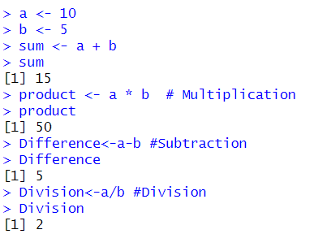
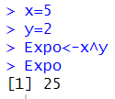
Basic Operations in R
Arithmetic operations
These include addition (+), Subtraction (-), Multiplication (*), Division (/) and exponentiation

Slide 4
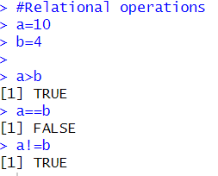
Basic Operations in R
II. Relational Operations
These are used for comparison and include greater than( >) or less than (<) and equal to(==) or not equal to (!=)

Slide 5


Basic Operations in R
III. Logical operations
Logical operations include AND(&) OR(|) and NOT (!)

Slide 6
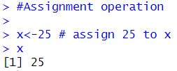
Basic Operations in R
IV Assignment operations
R uses assignment operator to assign values to the variable

Slide 7

Basic Operations in R

Slide 8
R data types
Numeric
Integers
Characters
Complex
The function that can be used to reveal data type are class()

Slide 9
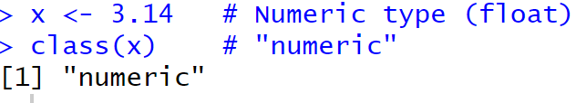
Numeric
Represents real numbers or floating point numbers.
Can include decimal points like 3.14,2.0, -7.5
Default Type: By default, numbers in R are stored as numeric, which means they are stored as floating-point numbers (with decimal precision).
Storage: Numbers are stored with double precision (64-bit floating point).

Slide 10
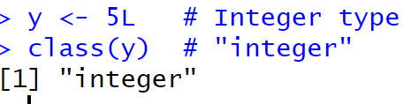
Integer
It represents whole numbers only
To create integer in R you need explicitly append L to the number
Integers store exact whole numbers. Any operation that introduces a decimal will convert an integer to numeric.
Integers are stored with less precision than numeric types (32-bit integer).
Key Difference:
Numeric can store both integers and floating-point numbers (with decimals), and it is the default type for numbers in R.
Integer explicitly stores whole numbers, using less memory compared to numeric.

Slide 11
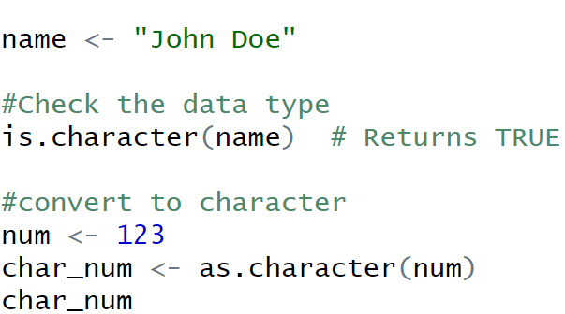
Character
Character data type is used to represent text strings. These are sequences of characters enclosed in either single (‘’) or double (“”) quotes.
You can check if variable is character using the is.character function.
To convert other data types to character use as.character() function

Slide 12
String operations
R provides several functions to work with character data
nchar(): counts number of character in the string
paste(): concatenate strings
substr(): Extracts a substring
strsplit(): split a string based on delimiter

Slide 13
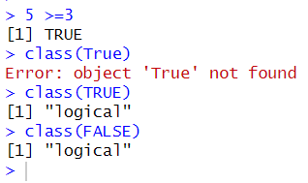

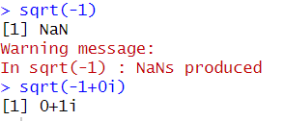

Logical
Integer
Complex
Character

Slide 14
Coercion
Coercion helps to convert one data type to another, e.g. logical “TRUE” value when converted into numeric yields “1”. Likewise, logical “FALSE” value yields “0”
We can use inbuilt type coercion function. To coerce your data into:
A logical, use as.logical()
An integer, use as.integer()
A double, use as.numeric()
A complex number, use as.complex()
String , use as.character()

Slide 15
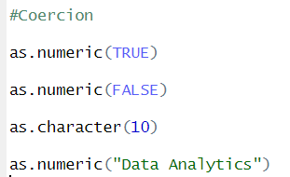
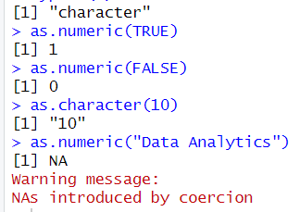
Coercion Demo in R
Code
Output
Non sensical coercion results in NAS

Slide 16
Data structures in R
A data structure is a particular way of organizing data in a computer so that it can be used effectively.
Data structures in R programming are tools for holding multiple values.
R’s base data structures are often organized by their dimensionality (1D, 2D, or nD) and whether they’re homogeneous (all elements must be of the identical type) or heterogeneous (the elements are often of various types).

Slide 17
Types of Data structures in R
Vector
List
Matrices
Factors
Data frames

Slide 18
Exercise on conditional statements, control flow statements

Slide 19
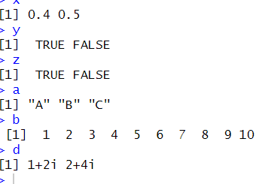
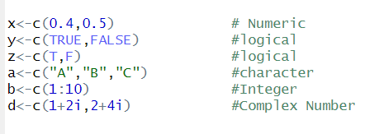
Vector
Simplest data structure in R
It is a sequence of data elements of same basic type
The c() function is used to create vector

Slide 20

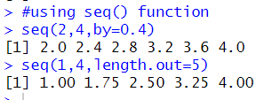
Different ways to create vector
There are also two ways in this. The first way is to set the step size and the second method is by setting the length of the vector.

Slide 21
Exercise on vectors

Slide 22
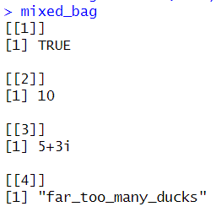
Lists
Special type of vector which contains elements of different classes
Indexing in R starts with 1 and in python it starts with 0.
We use list() function to create list instead of c()

Slide 23
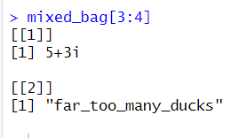

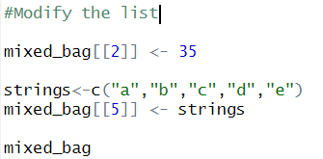
Basic Operations on lists
Subset a Lists
To access the element in the list without list use [[ ]] to access objects in the list
Modify the list and add element to it using double square bracket

Slide 24
Matrices
R-Matrix is a two-dimensional arrangement of data in rows and columns
In a matrix, rows are the ones that run horizontally and columns are the ones that run vertically. In R programming, matrices are two-dimensional, homogeneous data structures. These are some examples of matrices:
To create a matrix in R use Matrix function
Matrices are constructed column-wise so entries can be thought of starting in the upper left corner and running down the columns

Slide 25

Matrices
Syntax The basic syntax for creating a matrix in R is
data is the input vector which becomes the data elements of the matrix.
nrow is the number of rows to be created.
ncol is the number of columns to be created.
byrow is a logical clue. If TRUE then the input vector elements are arranged by row.
dimname is the names assigned to the rows and columns.

Slide 26
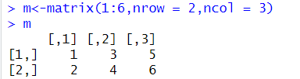

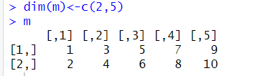
Different ways of creation of matrices
Matrices can directly be created by vectors by adding a dimension attribute

Slide 27
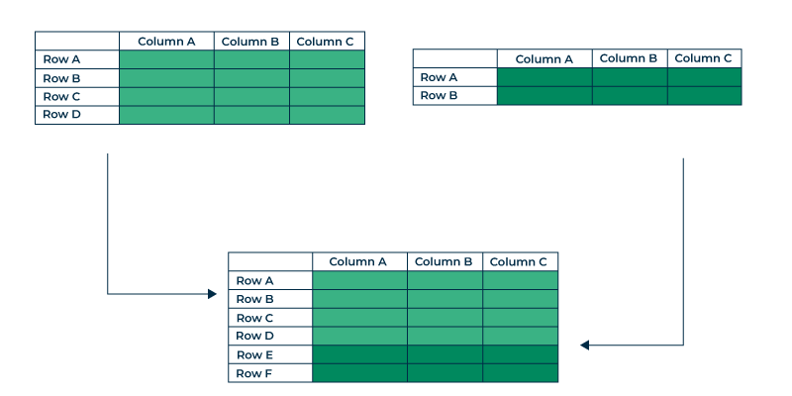
R bind

Slide 28
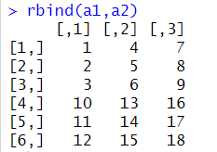
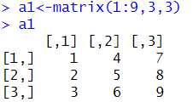
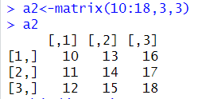
Practical usage of R-bind
The rbind function combines or concatenates data frames or matrices by rows. the rbind stands for row binds it shows that it appends rows of one object to another.
Final result using R bind
Create one Matrix
Create second Matrix

Slide 29
Factors
Factors are used to represent categorical data(ordered as well as unordered
It is an integer where each integer is label.
Factors with labels is better than using integer
e.g. having variables “male” and “female” is better than having values “0” and “1”
Factor can be created with the help of factor function
Identify factors in dataset (gender, availability, marital status )

Slide 30
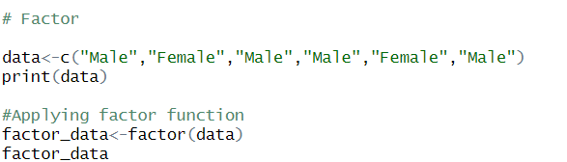
Creating a factor

Slide 31

Operators in R
Addition
Subtraction
Multiplication
Division
Exponent
Modulus
Integer Division
Arithmetic Operator
Logical Operator
NOT
AND
OR
Leftwards Assignment
Rightwards Assignment
Assignment Operator
Relational Operator
Greater than
Less than
Equal to
Not equal to

Slide 32
Missing values
Missing values are absent for specific variable in dataset
They are can be represented by various ways such as blank cells, symbols like NA
In many programming languages and data analysis tools, NA is used as a placeholder for missing values, allowing for proper handling during data processing.
In the context of data preprocessing, "NA" and "NAN" are used to represent missing values:
NA: Not Available
NAN: Not a Number

Slide 33
Missing values
During data preprocessing, handling these missing values appropriately is crucial for accurate analysis and modeling.
Common techniques include:
Imputation: Filling missing values with mean, median mode etc
Removal: delete rows which contains Null Values
Using Algorithms: Use appropriate ML algorithms which can handle missing values
NA Values have class also, so there are integer NA,character NA

Slide 34
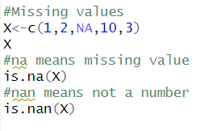
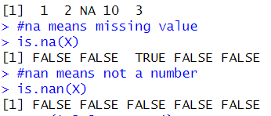
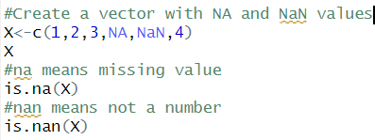
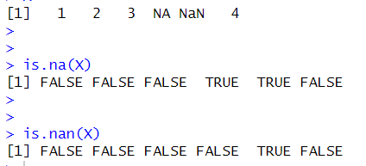
Examples of missing Number
CODE
OUTPUT

